Slide 1




PHP: Introduction
Syntax, Basic Web, Forms
PHP
SoftUni Team
Technical Trainers
Software University
http://softuni.bg

Slide 2


Table of Contents
What is PHP?
First PHP Script: Hello PHP
Variables, Conditions, Loops
Loops: Numbers 1 to 20
Generate Color Palette
HTML Forms with PHP
Hello, Person
Sum Two Numbers

Slide 3
Have a Question?
sli.do #tech-softuni

Slide 4


What is PHP?

Slide 5

What is PHP?
PHP (PHP Hypertext Preprocessor)
Server-side scripting language for building dynamic Web sites
PHP code is embedded in HTML pages
Rendered to HTML at the Web server
This is HTML code
<ul>
<?php for($i = 1; $i <= 20; $i++) { ?>
<li><?= $i ?></li>
<?php } ?>
</ul>
This is PHP code

Slide 6

Example: Hello PHP
Write PHP script to print "Hello PHP!"
hello.php
<?php
echo "Hello, PHP!";
?>
Check your solution here: https://judge.softuni.bg/Contests/Practice/Index/235#0

Slide 7
Variables in PHP
Variables in PHP are prefixed by $, e.g. $count
Not declared, created at first assignment
Variables have type, but it is not explicitly specified
echo $count; // Notice: Undefined variable: count
$count = 20; // variable $count, value 20 (integer)
echo $count . ' <br>'; // 20 <br>
echo gettype($count); // integer
var_dump($count); // int 20

Slide 8


Variables in PHP (2)
Checking whether a variable exists
isset(variable)
Deleting an existing variable
unset(variable)
$count = 20;
if (isset($count))
echo $count; // 20
unset($count);
echo $count; // Notice: Undefined variable: count

Slide 9
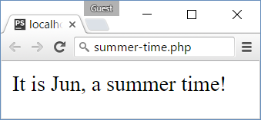
Conditions in PHP
PHP supports if-else and switch-case like C#, Java and JS
<?php $month = intval(date("m")); ?>
<?php if ($month >= 6 && $month <= 8) { ?>
<p>It is <?=date("M")?>, a summer time!</p>
<?php } else { ?>
<p>Sorry, not summer.</p>
<?php } ?>

Slide 10
Loops in PHP
PHP supports while, do-while, for and foreach loops
$count = 1;
while ($count <= 10) {
echo "<p>$count</p>";
$count++;
}
$i = 10;
do {
echo $i . "<br>\n";
$i--;
} while ($i > 0);
for ($i=0; $i<9; $i++) {
echo "<div>$i</div>";
}
$nums = array(1, 2, 3);
foreach ($nums as $x)
echo $x . "<br>";

Slide 11
Problem: Numbers 1 to 20
Write a PHP script to print the numbers from 1 to 20
Print the numbers in a list <ul><li>…</li></ul>
Print odd lines in blue, even lines in green
<ul>
<li><span style='color:blue'>1</span></li>
<li><span style='color:green'>2</span></li>
<li><span style='color:blue'>3</span></li>
…
</ul>

Slide 12
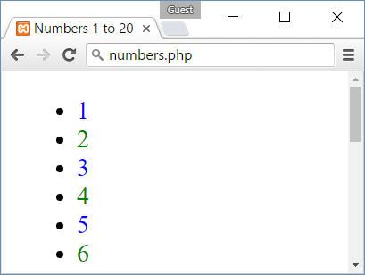
Solution: Numbers 1 to 20
<ul>
<?php
for ($i = 1; $i <= 20; $i++) {
if ($i % 2 == 0)
$color = 'green';
else $color ='blue';
echo "\t<li><span style='color:$color'> $i</span></li>\n";
} ?>
</ul>
Check your solution here: https://judge.softuni.bg/Contests/Practice/Index/235#1

Slide 13
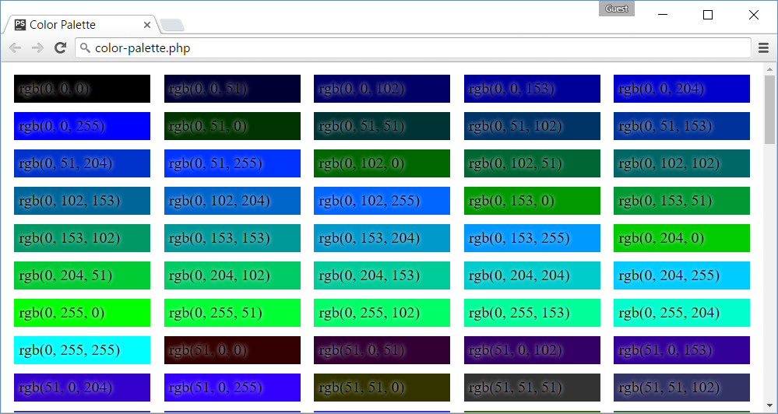
Problem: Color Palette
Write a PHP script to print a color palette like shown below:
<div style='background:rgb(0, 0, 0)'>rgb(0, 0, 0)</div>
<div style='background:rgb(0, 0, 51)'>rgb(0, 0, 51)</div>
…
<div style='background:rgb(0, 0, 255)'>rgb(0, 0, 255)</div>
<div style='background:rgb(0, 51, 0)'>rgb(0, 51, 0)</div>
<div style='background:rgb(0, 51, 51)'>rgb(0, 51, 51)</div>
<div style='background:rgb(0, 51, 102)'>rgb(0, 51, 102)</div>
…
<div style='background:rgb(0, 255, 255)'>rgb(0, 255, 255)</div>
<div style='background:rgb(51, 0, 0)'>rgb(51, 0, 0)</div>
…
<div style='background:rgb(255, 255, 255)'>rgb(255, 255, 255)</div>

Slide 14
Solution: Color Palette
<head><style>div { … }</style></head>
<body><?php
for ($red = 0; $red <= 255; $red += 51)
for ($green = 0; $green <= 255; $green += 51)
for ($blue = 0; $blue <= 255; $blue += 51) {
$color = "rgb($red, $green, $blue)";
echo "<div style='background:$color'> $color</div>\n";
}
?>
Check your solution here: https://judge.softuni.bg/Contests/Practice/Index/235#2

Slide 15
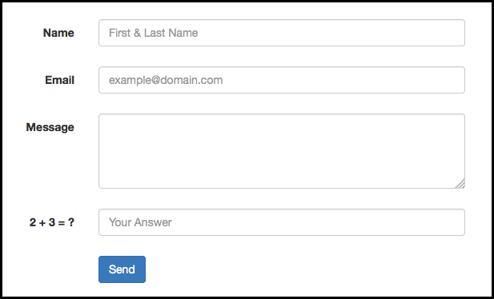
PHP Forms
Form Handling

Slide 16
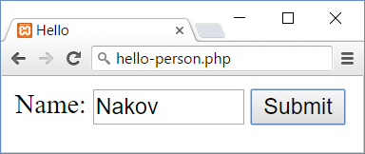
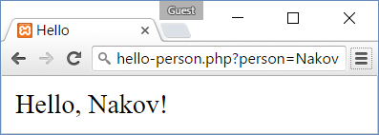
Submitting HTML Forms
HTML forms submit data to some URL
hello-person.php
<form>
Name: <input type="text" name="person" />
<input type="submit" />
</form>
hello-person.php?person=some_value

Slide 17
HTML Forms and PHP: Hello, Person!
<?php
if (isset($_GET['person'])) {
$person = htmlspecialchars($_GET['person']);
echo "Hello, $person!";
} else {
?>
<form>
Name: <input type="text" name="person" />
<input type="submit" />
</form>
<?php } ?>
If the 'person' HTTP GET parameter exists, print a greeting
Otherwise, show a HTML form to enter a person
Check your solution here: https://judge.softuni.bg/Contests/Practice/Index/235#3

Slide 18
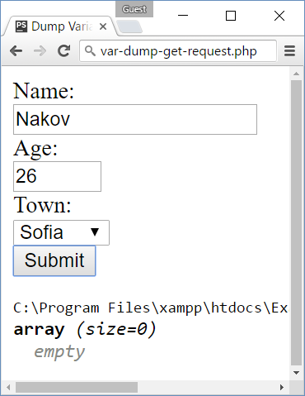
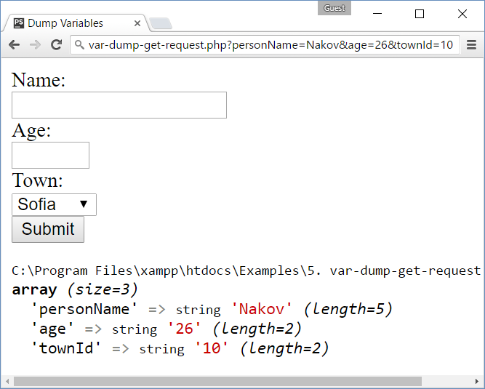
Problem: Dump a HTTP GET Request
Write a PHP script to dump the content of the HTTP GET request parameters using var_dump(…)

Slide 19
Solution: Dump a HTTP GET Request
<form>
<div>Name:</div><input type="text" name="personName" />
<div>Age:</div><input type="number" name="age" />
<div>Town:</div>
<select name="townId">
<option value="10">Sofia</option>
<option value="20">Varna</option>
<option value="30">Plodvid</option>
</select>
<div><input type="submit" /></div>
</form>
<?php var_dump($_GET); ?>
All parameters will be passed as string values in $_GET[] array
Dump the $_GET[] array
Check your solution here: https://judge.softuni.bg/Contests/Practice/Index/235#4

Slide 20
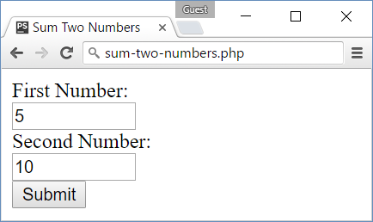
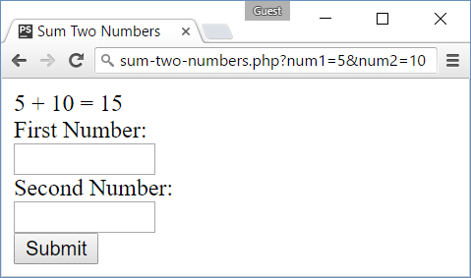
Problem: Sum Two Numbers
Write a PHP script to sum two numbers
The script should display a HTML form to enter the numbers
If the numbers are passed as parameters, display their sum

Slide 21
Solution: Sum Two Numbers
<?php if (isset($_GET['num1']) && isset($_GET['num2'])) {
$num1 = intval($_GET['num1']);
$num2 = intval($_GET['num2']);
$sum = $num1 + $num2;
echo "$num1 + $num2 = $sum";
} ?>
<form>
<div>First Number:</div>
<input type="number" name="num1" />
<div>Second Number:</div>
<input type="number" name="num2" />
<div><input type="submit" /></div>
</form>
Sum the 'num1' and 'num2' values if exist
Show a HTML form to submit num1 and num2
Check your solution here: https://judge.softuni.bg/Contests/Practice/Index/235#5

Slide 22

PHP Functions
Function definition, calling

Slide 23
Functions in PHP
Functions can encapsulate a piece of code
Logically equivalent to methods in C#, functions in other languages
function sum($a, $b)
{
return $a + $b;
}
echo sum(2, 3) . "<br>\n"; // 5
echo sum(2.8, 2) . "<br>\n"; // 4
echo sum(3, 3) . "<br>\n"; // 6
Take parameters
Return summed result

Slide 24
Type-Hinting
Functions can define the types of parameters and return values
Types: int, float, string, bool, array, callable, SomeClass
function sum(int $a, int $b) : int
{
return $a + $b;
}
echo sum(2, 3) . "<br>\n"; // 5
echo sum(2.8, 2) . "<br>\n"; // 4
echo sum(3, 3) . "<br>\n"; // 6
Take int parameters
return int result
float values converted to int
4 = (int)2.8 + (int)2

Slide 25
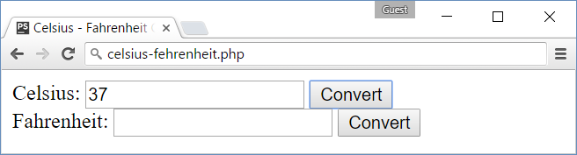
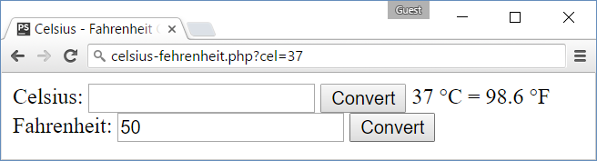
Problem: Celsius ↔ Fahrenheit
Write a PHP script to convert from Celsius to Fahrenheit
Print the result in format "132.8 °F = 56 °C" (use &deg; for °)

Slide 26
Solution: Celsius ↔ Fahrenheit
Define the degree conversion functions
function celsiusToFahrenheit(float $celsius) : float
{
return $celsius * 1.8 + 32;
}
function fahrenheitToCelsius(float $fahrenheit) : float
{
return ($fahrenheit - 32) / 1.8;
}

Slide 27
Solution: Celsius ↔ Fahrenheit (2)
Prepare the message to be shown after the Celsius form
$msgAfterCelsius = "";
if (isset($_GET['cel'])) {
$cel = floatval($_GET['cel']);
$fah = celsiusToFahrenheit($cel);
$msgAfterCelsius = "$cel &deg;C = $fah &deg;F";
}
$msgAfterFahrenheit = "";
if (isset($_GET['fah'])) {
$fah = floatval($_GET['fah']);
$cel = fahrenheitToCelsius($fah);
$msgAfterFahrenheit = "$fah &deg;F = $cel &deg;C";
}
Use &deg; to show the ° symbol

Slide 28
Solution: Celsius ↔ Fahrenheit (3)
<form>
Celsius: <input type="text" name="cel" />
<input type="submit" value="Convert">
<?= $msgAfterCelsius ?>
</form>
<form>
Fahrenheit: <input type="text" name="fah" />
<input type="submit" value="Convert">
<?= $msgAfterFahrenheit ?>
</form>
Check your solution here: https://judge.softuni.bg/Contests/Practice/Index/238#0

Slide 29
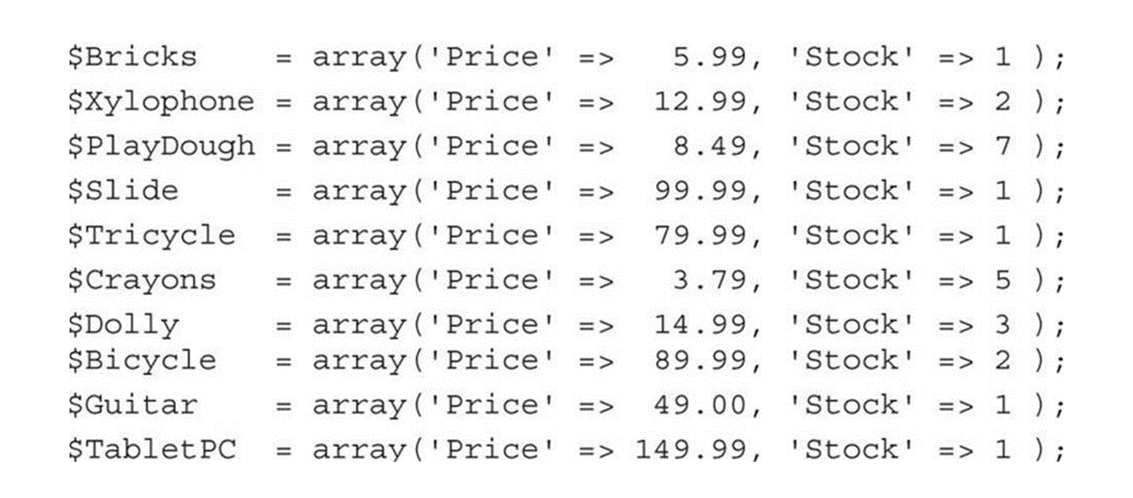
Collections
Arrays, Associative Arrays

Slide 30
Arrays
Arrays in PHP hold indexed sequence of values
$towns = array('Sofia', 'Plovdiv', 'Varna');
echo $towns[0] . "<br>\n"; // Sofia
echo implode(", ", $towns); // Sofia, Plovdiv, Varna
$nums = [10, 20, 30, 40, 50];
for ($i = 0; $i < count($nums); $i++)
$nums[$i] = $nums[$i] * 2;
$nums[] = 1; // Add element 1 to $num
echo implode(", ", $nums); // 20, 40, 60, 80, 100, 1

Slide 31
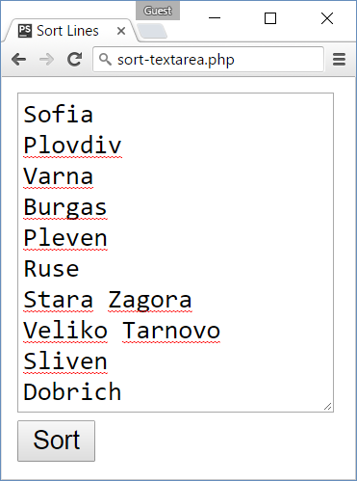
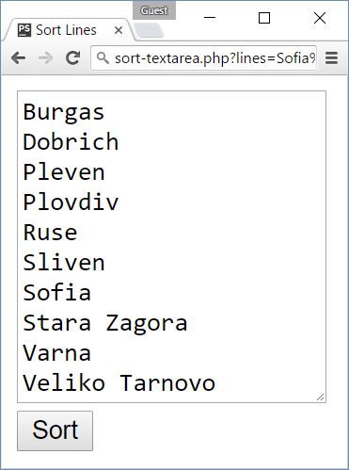
Problem: Sort Text Lines
Write a PHP script that sorts the text lines from a <textarea>

Slide 32
Solution: Sort Text Lines
Split by new line "\n". Warning: '\n' does not work!
<?php $sortedLines = "";
if (isset($_GET['lines'])) {
$lines = explode("\n", $_GET['lines']);
$lines = array_map('trim', $lines);
sort($lines, SORT_STRING);
$sortedLines = implode("\n", $lines);
} ?>
<form>
<textarea rows="10" name="lines"><?= $sortedLines
?></textarea> <br>
<input type="submit" value="Sort">
</form>
Remove \r and spaces when exist
Sort as string values
Warning: '\n' will not work!
Never put space between <textarea> and </textarea>
Check your solution here: https://judge.softuni.bg/Contests/Practice/Index/238#1

Slide 33
Associative Arrays
Associative arrays in PHP hold {key → value} pairs
$ages = ["Nakov" => 25, "Maria" => 22, "George" => 12];
echo $ages['Nakov'] . "<br>\n"; // 25
$ages['Kiro'] = 15; // Add new key-value pair
$ages['Nakov'] = 26; // Change existing value for given key
unset($ages['George']); // Delete existing key
$ages['Maria'] = 'no age'; // Mixing types is allowed
foreach ($ages as $name => $age) {
echo "Name: $name, age: $age<br>\n";
}

Slide 34
Strings in PHP
Strings in PHP hold a sequence of non-Unicode characters (bytes)
$lang = 'PHP';
$str = "I love $lang<br>\n";
echo $str; // I love PHP<br>
$broken = 'I love $lang<br>\n';
echo $broken; // I love $lang<br>\n
$tokens = explode(',', 'PHP,,,, SQL, HTML, Java');
$tokens = array_filter(array_map('trim', $tokens));
echo strtolower(implode(' - ', $tokens));
// php - sql - html - java

Slide 35
Problem: Extract Capital-Case Words
Write a PHP script to extract from array of strings all capital-case words. All non-letter chars are considered separators.
We start by HTML, CSS, JavaScript, JSON and REST.
Later we touch some PHP, MySQL and SQL.
Later we play with C#, EF, SQL Server and ASP.NET MVC.
Finally, we touch some Java, Hibernate and Spring.MVC.
HTML, CSS, JSON, REST, PHP, SQL, C, EF, SQL, ASP, NET, MVC, MVC
Check your solution here: https://judge.softuni.bg/Contests/Practice/Index/238#4

Slide 36
Solution: Extract Capital-Case Words
Extract all non-empty sequences of letters \w+ in new array $words
if (isset($_GET['text'])) {
$text = $_GET['text'];
preg_match_all('/\w+/', $text, $words);
$words = $words[0];
$upperWords = array_filter($words, function($word){
return strtoupper($word) == $word;
});
echo implode(', ', $upperWords);
}
// TODO: make HTML form holding <textarea name="text">
$words holds array of arrays of strings
Check your solution here: https://judge.softuni.bg/Contests/Practice/Index/238#4

Slide 37
Classes and Objects
class Student
{
protected $name;
protected $age;
function __construct($name, $age)
{
$this->name = $name;
$this->age = $age;
}
public function __toString()
{
return "Name: $this->name; Age: $this->age";
}

Slide 38
Classes and Objects (2)
function getName()
{ return $this->name; }
function setName($name)
{ return $this->name = $name; }
function getAge()
{ return $this->age; }
function setAge($age)
{ return $this->age = $age; }
}

Slide 39

Summary
PHP is a server-side scripting language
Variables are prefixed by $, not declared
PHP supports classical if-else statements
PHP supports classical loop structures:
while , do-while , for, foreach
HTML forms send data as HTTP GET request
Access HTTP GET parameters from PHP using $_GET['param_name']
PHP Supports classic collections and constructions
Functions, arrays, associative arrays, classes

Slide 40









PHP: Syntax, Basic Web
https://softuni.bg/courses/software-technologies

Slide 41
License
This course (slides, examples, demos, videos, homework, etc.) is licensed under the "Creative Commons Attribution-NonCommercial-ShareAlike 4.0 International" license

Slide 42





Trainings @ Software University
Software University Foundation – softuni.org
Software University – High-Quality Education, Profession and Job for Software Developers
softuni.bg
Software University @ Facebook
facebook.com/SoftwareUniversity
Software University Forums – forum.softuni.bg

